Slide 1
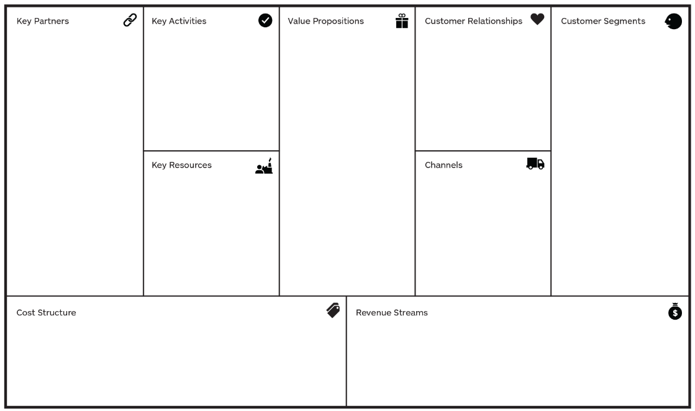

Slide 2
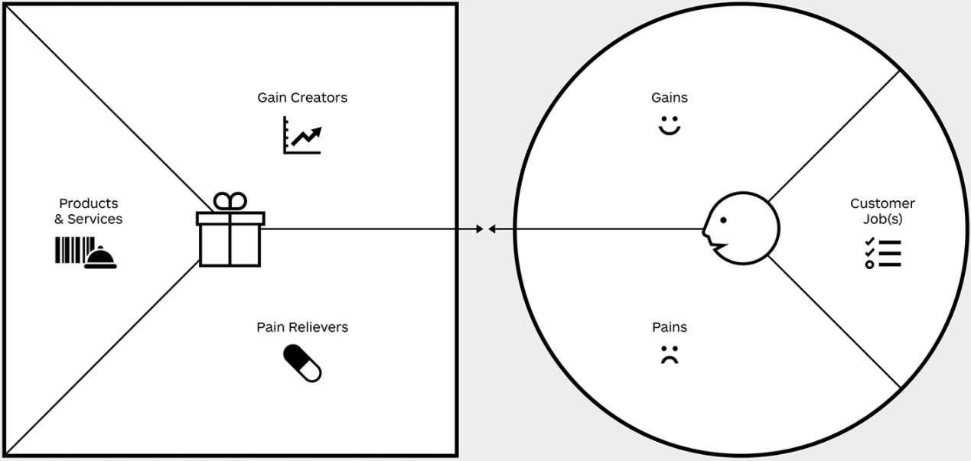

Slide 3
Revenue per unit sold
Cost per Unit Cost of Goods Sold – Direct Input costs
Gross Profit
Fixed Costs Rent, Loan amortization for equipment, Salaries, Utilities
Selling General & Admin Expenses Marketing, Distribution, Merchandizing, Admin
Net Profit

