Slide 1
YOUNG AFRICA WORKS Creating Opportunities for All to Learn and Prosper
Mastercard Foundation
March 21, 2019

Slide 2
Mastercard Foundation Today
Created by Mastercard International in 2006 as a separate, independent foundation.
Today, the Mastercard Foundation’s assets have grown to $21.2 billion, making it the third largest private foundation in the world.
Based in Toronto, Canada with an office in Kigali, Rwanda and soon in Kenya, Ghana and Senegal.
Working in 34 African countries.
130 dedicated and diverse employees.
Partnered with 146 organizations.
Launched the Young Africa Works strategy with the goal of enabling 30 million young people in Africa to secure dignified and fulfilling work.

Slide 3
Our Vision: Seeking a world where everyone has the opportunity to learn and prosper.
Our Mission: To advance learning and promote financial inclusion for people living in poverty.

Slide 4
Programs have improved the lives of over 33 million people and millions more in their households or through the businesses that they support.
54% of participants and young people are female.
52% of participants and young people live in rural communities.
70% of participants and young people reported improved well-being.
76% of participants in youth livelihoods programs have transitioned to jobs, entrepreneurship, or education.

Slide 5
MCF Current Agriculture Portfolio ($M)
* NB: Pipeline = MSU, ideas42 and FRP Innovation 2
** NB: Current programs only
Notes:
Doesn’t include mmgt grants – all board approved. Closed: mmgt grants largely on FRP prep and YL, BRAC, Swisscontact I, TNS I,
Total projects + pipeline = 463.73
Pipeline = MSU, ideas42, Innovation Round 2
Program breakdown (Current only, doesn’t include Pipeline)
EL RUFORUM C 27.10
EL Ag Universities (EARTH, MSU, Pretoria) C 85.90
113.00
FI AgDevCo - Smallholder Development Unit C 14.00
FI AGRA - FISFAP C 15.50
FI CGAP (WAEMU) C 0.30
FI CGAP (2016) C 2.00
FI Dalberg/GDI Learning Partnership C 6.50
FI ICCO - Strengthening African Rural Smallholders C 17.72
FI IFC- Partnership for Financial Inclusion C 1.75
FI KCB - Ag program for pastoralists and SHFs C 15.47
FI Kiva Labs C 7.89
FI KPMG (FRP Innovation 1) C 6.95
FI KPMG (FRP Scaling 1) C 10.67
FI Mercy Corps C 24.69
FI OI 2013 C 22.68
FI One Acre Fund C 9.90
FI Root Capital C 5.21
161.23
YL ICIPE C 10.00
YL Save the Children C 40.00
YL SNV C 13.80
YL Technoserve C 26.10
YL Heifer C 18.00
YL NCBA-CLUSA C 11.40
YL Solidaridad C 15.00
YL Goal C 21.30
YL Swisscontact C 4.08
YL CAP C 3.50
163.18

Slide 6
Country Breakdown in Investment in Ag (> $10M)
*NB: Does not include Kiva Labs, RAF Learning Lab, RUFORUM, Ag universities, CGAP, which are pan-African
Notes:
NB: Only showing above $10M, current partnerships only
(Total of 10 programs in Tanzania)

Slide 7
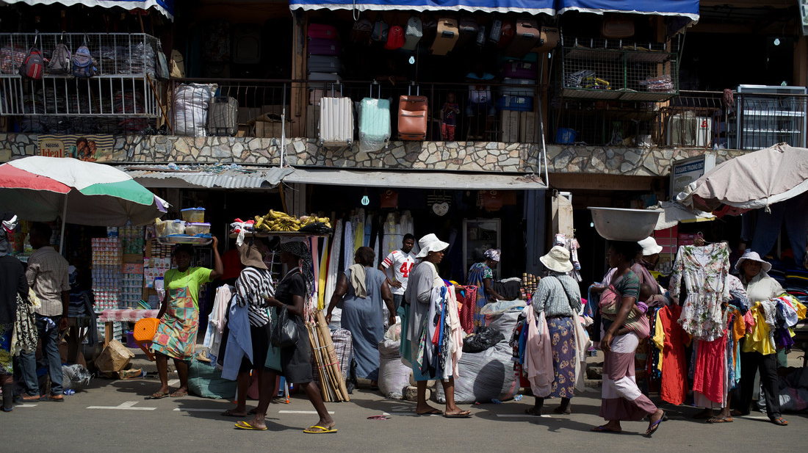
Why Africa?

Slide 8
Key Statistics
Population
Financial Inclusion
75%
75% of the population is under age 35.
Only 43% of the population has access to formal financial services.
Economic Growth Rate
Income
90%
6% growth rate per year over the next two decades.
~90% of the population lives on less than $10 per day.
Literacy
Education
21% increase in literacy rate by 2030.
Lowest global education attainment rates: only 27% complete secondary education and 7% complete higher education.
Mobile Subscriptions
921% increase in mobile subscriptions by 2030.

Slide 9
Challenges to be Addressed
By 2035, there will be more young people entering Africa’s workforce each year than in the rest of the globe combined.
A significant gap exists between the number of young people seeking work and the limited employment opportunities available to them.
There is a mismatch between the skills demanded by the market and the training young people receive.
There are barriers to link job seekers with employers or entrepreneurship opportunities.

Slide 10
The Time is Right
Demographic shift presents an opportunity for economic transformation.
Historic African Continental Free Trade Area Agreement signing on the 21st of March 2018 will create new opportunities for economic growth in Africa.
Africa has the highest rate of digital penetration and adoption.
Young people are driving a growing entrepreneurial culture powered by technology.
The Foundation believes it is uniquely positioned to serve the continent through its partnerships with governments, educational institutions and the private sector, and because of its core values of collaboration, humility, and respect.

Slide 11
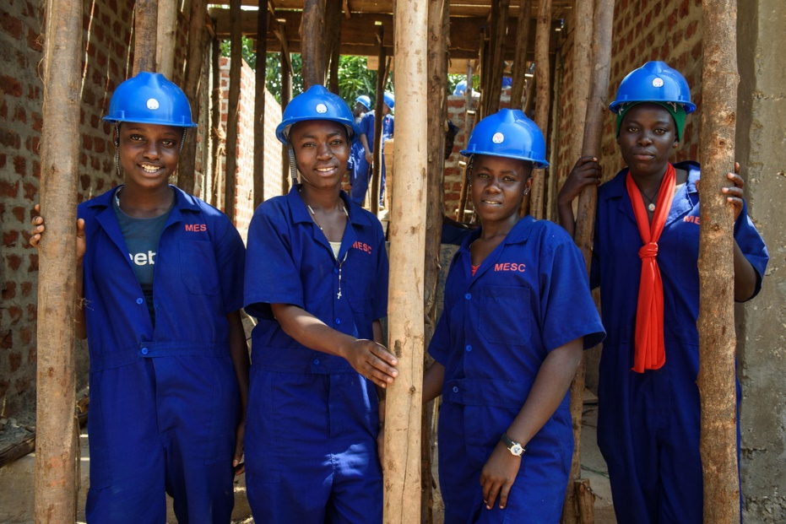
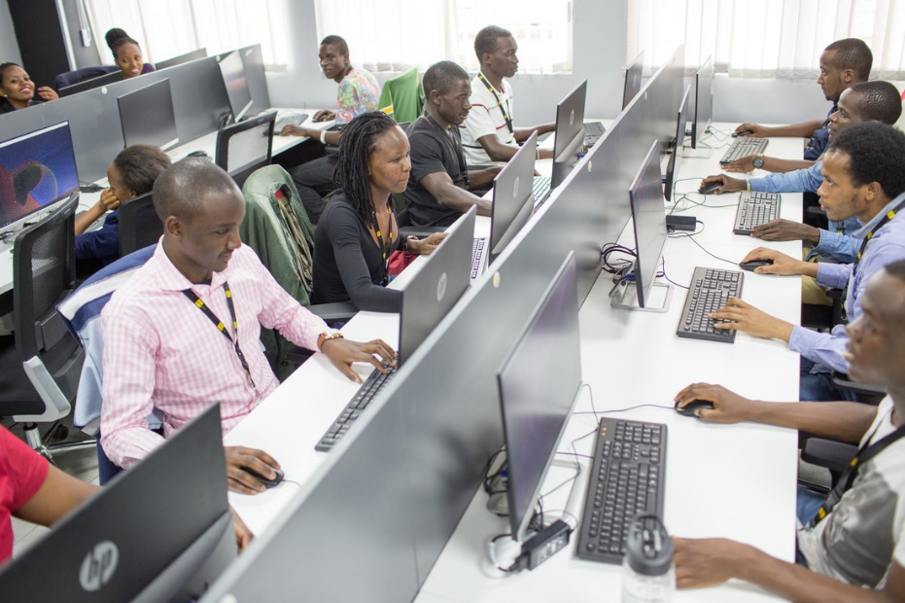
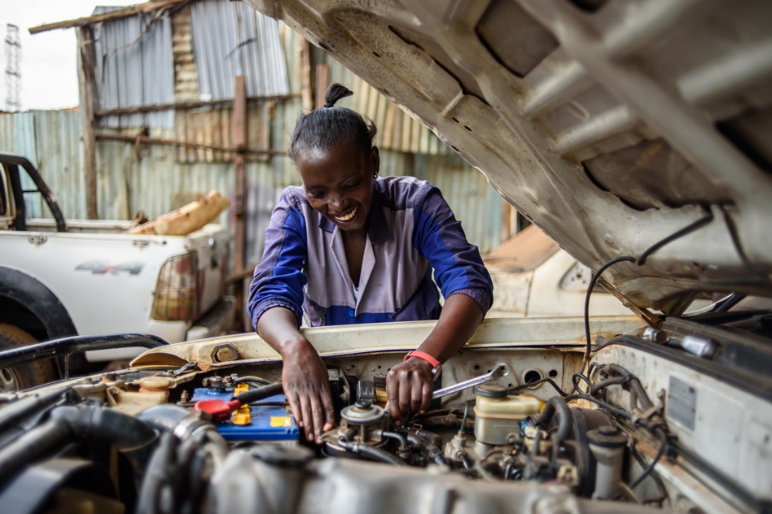
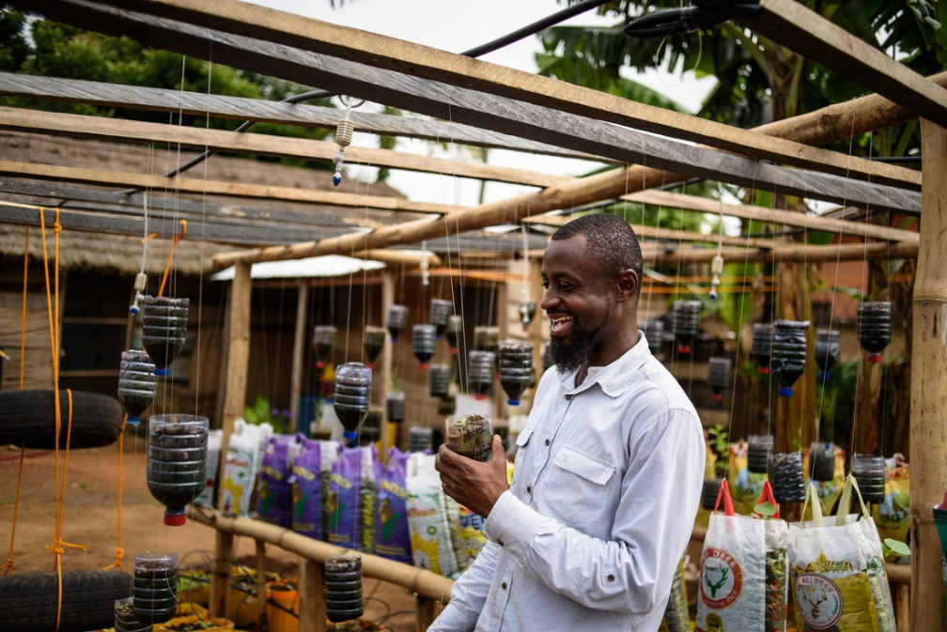
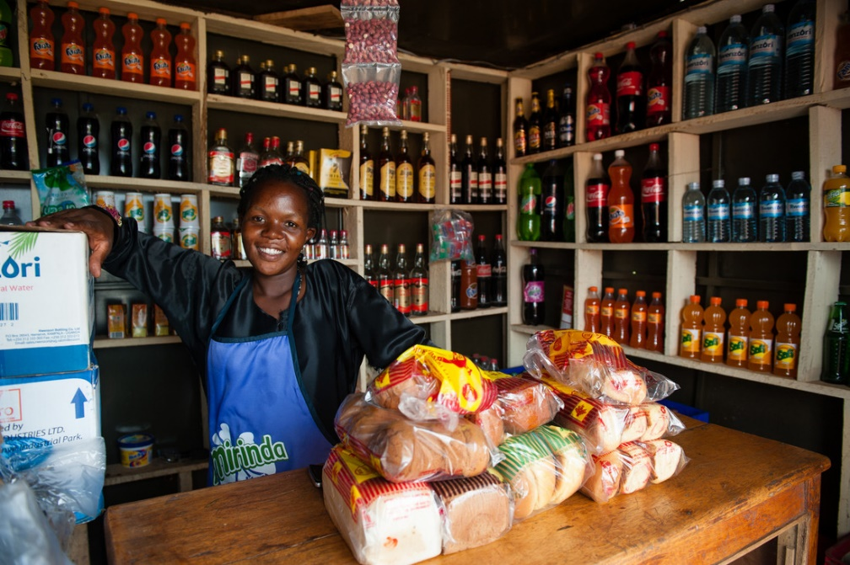
Young Africa Works

Slide 12
Young Africa Works
Our goal is to enable 30 million young people in Africa, particularly young women, to secure dignified and fulfilling work by 2030.
How will we achieve this?
Implement 10 country-specific programs that:
Strengthen education and vocational training systems so young people can acquire the skills the market needs.
Grow small businesses and entrepreneurship through access to financial services.
Connect job seekers to employers.
Implement regional programs to drive education, entrepreneurship, and digital innovation to improve financial inclusion.
Work with African organizations, including government, the private sector, and other funders.
Empower young women.
Use technology to drive impact and scale.
Build and share evidence of what works.

Slide 13
Co-Creating Country Strategies
Over the past year, the Foundation has been actively engaging with government, the private sector, donors, and young people in the target countries to solicit their ideas and align strategies.
Meeting with Heads of State and government ministers.
Conducting in-country research and analysis.
Determining where we have a comparative advantage to:
Enhance the growth of key industries.
Strengthen education and vocational training systems.
Support job-generative entrepreneurs.
Connect young people to employment opportunities.
Common elements across the target countries:
Enablers:
Affordable finance for entrepreneurs.
Relevant and quality education.
Effective transitions and linkages.
Evidence to support policy.
Strong digital economy.
Sectors:
Agriculture, agro-processing, and agribusiness.
Services.
Creative industries.

Slide 14
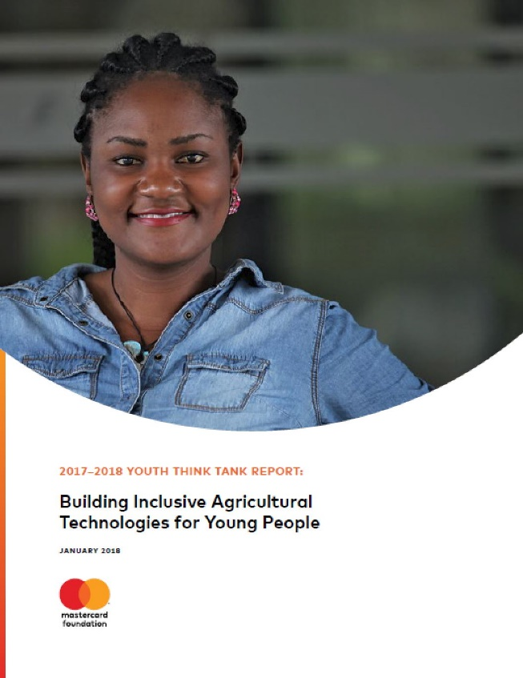
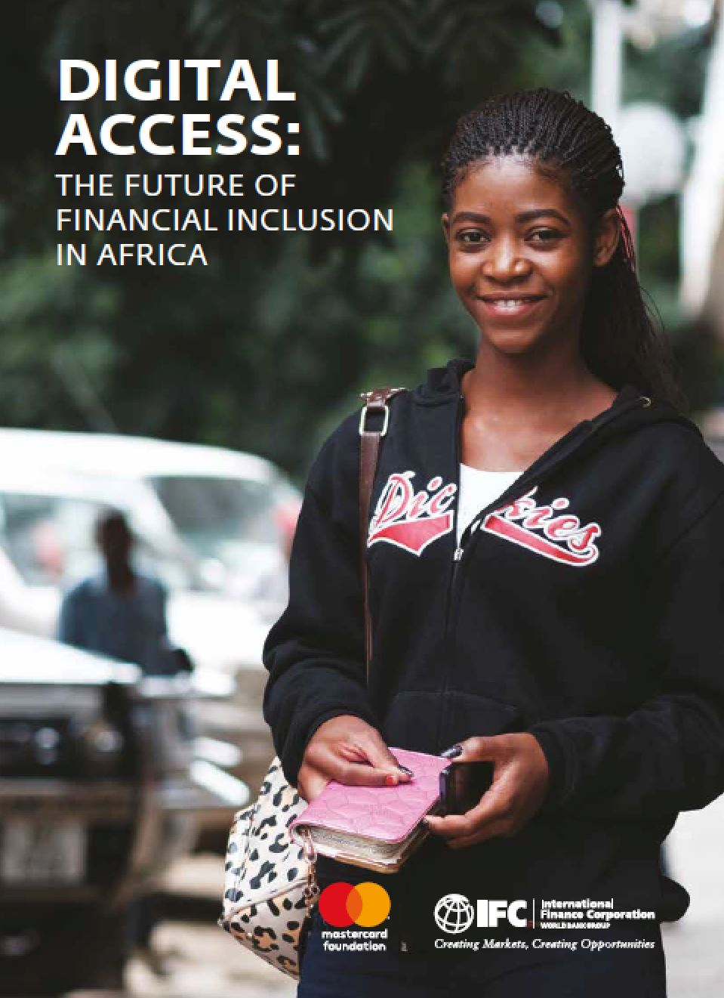
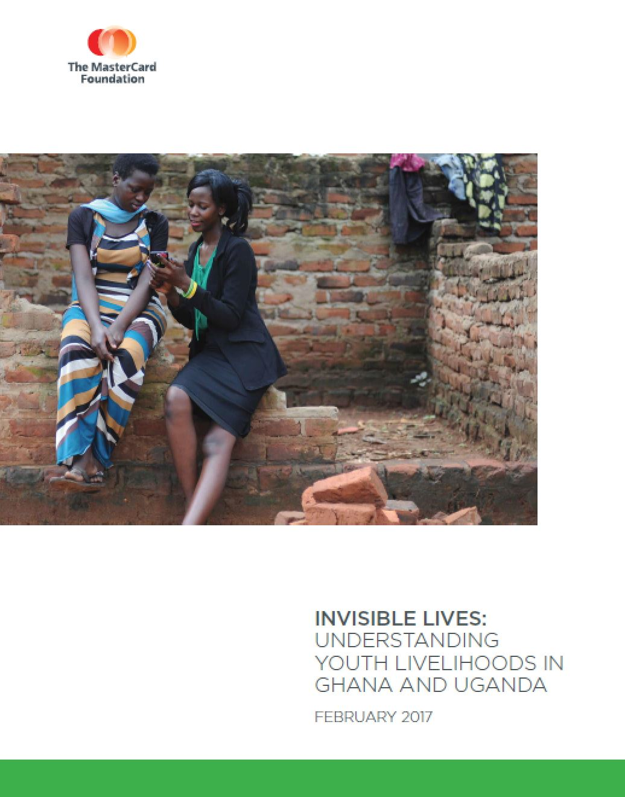
Building Evidence for What Works
Research, Evaluation, and Learning
Generate new evidence that demonstrates how to address youth employment in Africa.
Catalyze innovation, and influence and inspire others to act.

Slide 15
What we are Learning – Agriculture
Agriculture is a preferred field of study for tertiary scholars. Of those studying agriculture, 43% are in agribusiness, 24% in environmental sciences, and 43% in general agriculture.
Scholars name agriculture as their top social change and career aspiration.
Within the Scholars network, the definition of Agriculture is trans-disciplinary and embraces many fields of sciences, partnerships with the private sector and with governments.
Given the rural background of many Scholars and their dedication to sustainable and inclusive development, the entire Scholars network is a potential partner when exploring programming in agriculture.
The RUFORUM program aims to improve the quality of agricultural education and scale learning to the larger RUFORUM network of 105 agricultural universities. It provides a strong entry point to a continent-wide network of leaders in agricultural education in Africa.
Notes:
278 Scholars enrolled in Agriculture (135 female, 143 male)
43% general ag
33% agribusiness
24% environmental sciences

Slide 16
Constraints to Employment in Agriculture
Access to knowledge and demand driven skills
Access to financial education, products and services
Access to extension and vocational training
Access to land
Access to agricultural/rural markets
Climate change
Access to appropriate technology and innovation
Poor image of agriculture by young people
Young women face unique challenges in the agriculture sector
Exclusion of youth in policy discussions and instituted policies
Notes:
MCF will be largely unable to address issues around access to land, and possibly regarding climate change and policy – however the others are all possibilities for investment

Slide 17
Considerations for Foundation’s Agriculture Strategy
Alignment with national development strategy
Empowering women
Engaging with farmers and farmer cooperatives
Focusing on the quality as well as the quantity of agricultural products and services
Creating a thriving rural economy that provides youth with decent employment and entrepreneurship opportunities
Protecting the environment
Youth differentiation/segmentation
Approach to partnership
Notes:
Valuing the Client - any rational food system for Africa must put smallholders at the center of how we think about food and agriculture. This means adjusting to a vision of African farmers as profitable business actors.
Women - If women farmers in Africa had the same access to land, credit and services as men, farm productivity would increase by up to 20%.
Quality and quantity of food - faulty food systems that focused on increasing production only have meant that undernutrition persists. In Africa, undernutrition and obesity exist side by side in many of the same communities.
Rural economy with employment opportunities - every step in the food system can be an opportunity for entrepreneurial activity, so in theory a healthy food system could nurture an entire rural sector that creates wealth and provides off-farm employment opportunities.
Environmental protection - expansion of agricultural land will involve degradation of natural ecosystems. Greater investment is needed in location-specific crop and animal science and extension programs.
Youth segmentation - Considering non-homogeneity of youth in designing solutions

Slide 18
Scholars Program Contribution to YAW
Partner with new universities based in Africa that share Foundation ethos of socioeconomic and gender equity in recruitment
Target: 15000 new scholarships by 2023
70% women
25% displaced youth
10% diasabled youth
Pro-gender and inclusive recruitment policies
A culture of Collaborative partnerships
Ability to welcome large numbers of new students
Institutional buy-in - influencing / transformation
Focus on transition supports
Pragmatic experiential learning
Linkages with industry and private sector –Internship/Recruitment
Entrepreneurship training
Transformative Leadership training
Community give back
Career guidance
Psycho-social support and counseling
Mentoring

